Slide 1

6th Grade Math
Unit 9, Lesson 6 Describing and Interpreting Histograms – Part 1 Volume 2, pg. 173

Slide 2


Benchmark
MA.6.DP.1.4
Given a histogram or line plot within a real-world context, qualitatively describe and interpret the spread and distribution of the data, including any symmetry, skewness, gaps, clusters, outliers, and the range.
volume 2, pg. 173

Slide 3
Integrated Mathematical Thinking and Reasoning Standards
MA.K12.MTR.4.1 Engage in discussions that reflect on the mathematical thinking of self and others.
MA.K12.MTR.7.1 Apply mathematics to real-world contexts.
volume 2, pg. 173

Slide 4

Learning Target
I can qualitatively describe and interpret a histogram within a real-world context.
volume 2, pg. 173

Slide 5

Warm-Up
volume 2, pg. 174

Slide 6

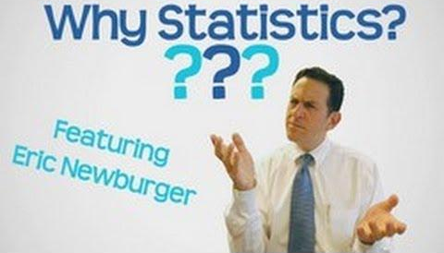
9.6.1 Warm-Up: Why Statistics?
Eric Newburger relates the need for studying statistics to the need for using a microscope. He discusses how a microscope is used to study small things. It’s also needed to study things like food poisoning at a larger level to aid in understanding diseases and how viruses spread.
In Mr. Newburger’s work, he explains you can take a big thing and shrink it down small enough to study and to understand. That’s the study of statistics. And when you want to understand something that is too small, you can use a tool (like the microscope), which is “why statistics.”
volume 2, pg. 174

Slide 7
List two reasons why statistics are important.
volume 2, pg. 174

Slide 8

Guided Instruction
volume 2, pg. 174

Slide 9

9.6.2 Guided Instruction: Histograms
Numerical data can be displayed graphically in a variety of ways. One type of graph is a histogram.
A histogram is a visual display of numerical data using bars along a number line with no spaces between the bars. The height of each bar represents either the frequency or relative frequency of data within that interval.
volume 2, pg. 174

Slide 10
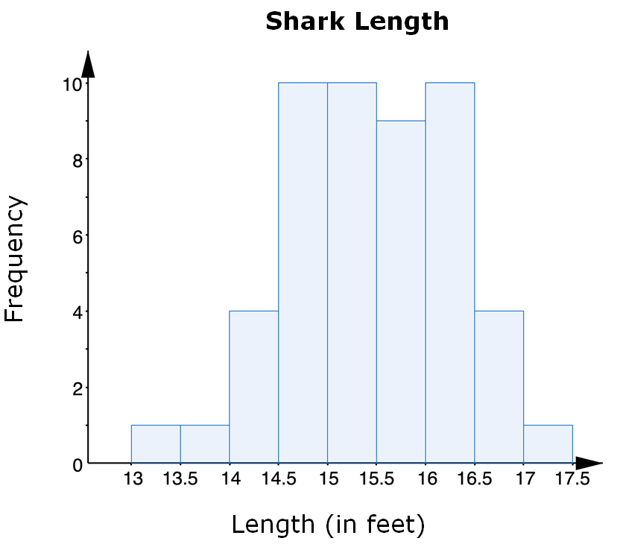
The histogram summarizes the lengths, in feet (ft), of a group of adult female sharks.
With your partner, discuss the labels for the vertical and horizontal axes.
volume 2, pg. 174

Slide 11
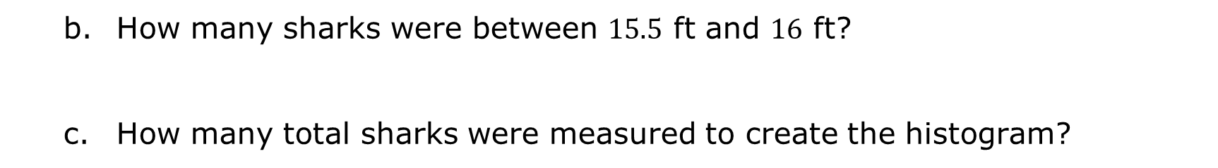
How many sharks were between $15.5$ ft and $16$ ft?
How many total sharks were measured to create the histogram?
volume 2, pg. 175

Slide 12
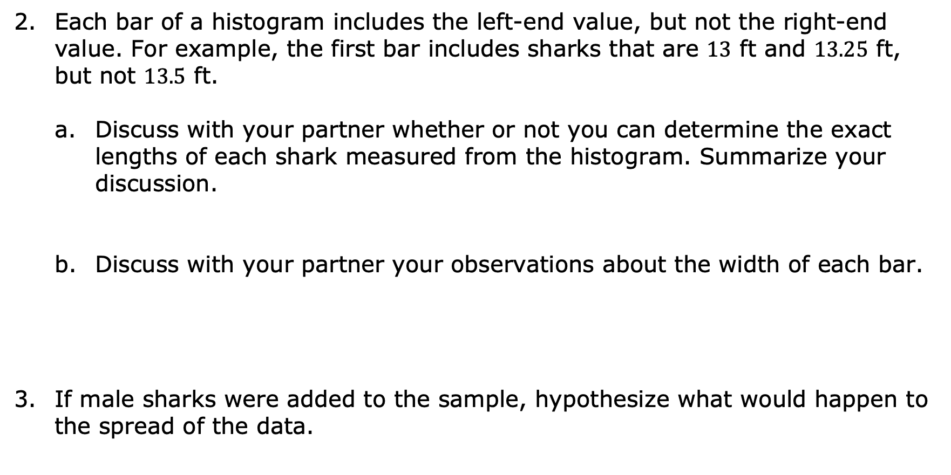
Each bar of a histogram includes the left-end value, but not the right-end value. For example, the first bar includes sharks that are $13$ ft and $13.25$ ft, but not $13.5$ ft.
Discuss with your partner whether or not you can determine the exact lengths of each shark measured from the histogram. Summarize your discussion.
Discuss with your partner your observations about the width of each bar.
If male sharks were added to the sample, hypothesize what would happen to the spread of the data.
volume 2, pg. 175

Slide 13

Exploration
volume 2, pg. 175

Slide 14

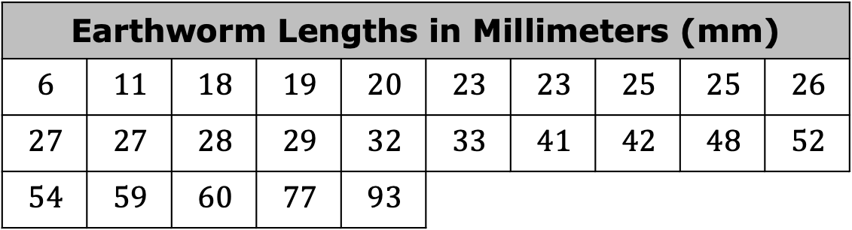
9.6.3 Exploration: Histograms
An earthworm farmer set up several containers of a certain species of earthworm so he could learn about their lengths. Lengths of earthworms provide information about their ages. The farmer measured the lengths of the earthworms in one container.
The farmer recorded the earthworms’ lengths, in millimeters, in a table and then created a histogram to display the data.
Earthworm Lengths in Millimeters (mm)
$$6$$ | $$11$$ | $$18$$ | $$19$$ | $$20$$ | $$23$$ | $$23$$ | $$25$$ | $$25$$ | $$26$$
$$27$$ | $$27$$ | $$28$$ | $$29$$ | $$32$$ | $$33$$ | $$41$$ | $$42$$ | $$48$$ | $$52$$
$$54$$ | $$59$$ | $$60$$ | $$77$$ | $$93$$
volume 2, pg. 175

Slide 15
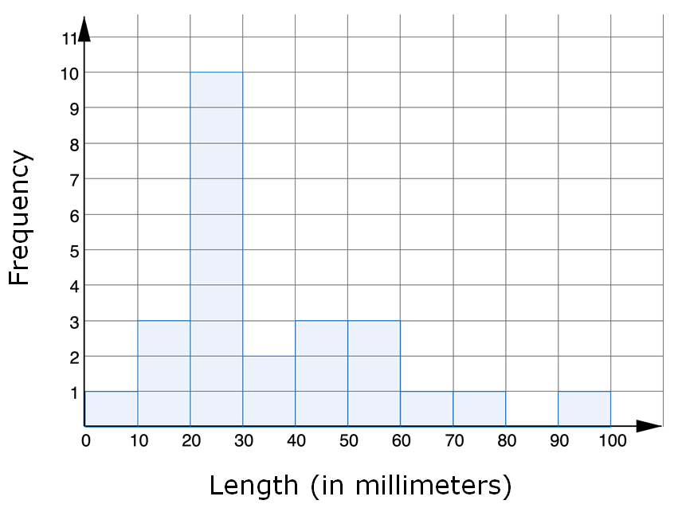
volume 2, pg. 175

Slide 16
How many earthworms were measured in the data?
The number of earthworms measured can be determined from
The length of the shortest earthworm can be determined from
the data set.
the histogram.
the data set and the histogram.
the data set.
the histogram.
the data set and the histogram.
volume 2, pg. 176

Slide 17
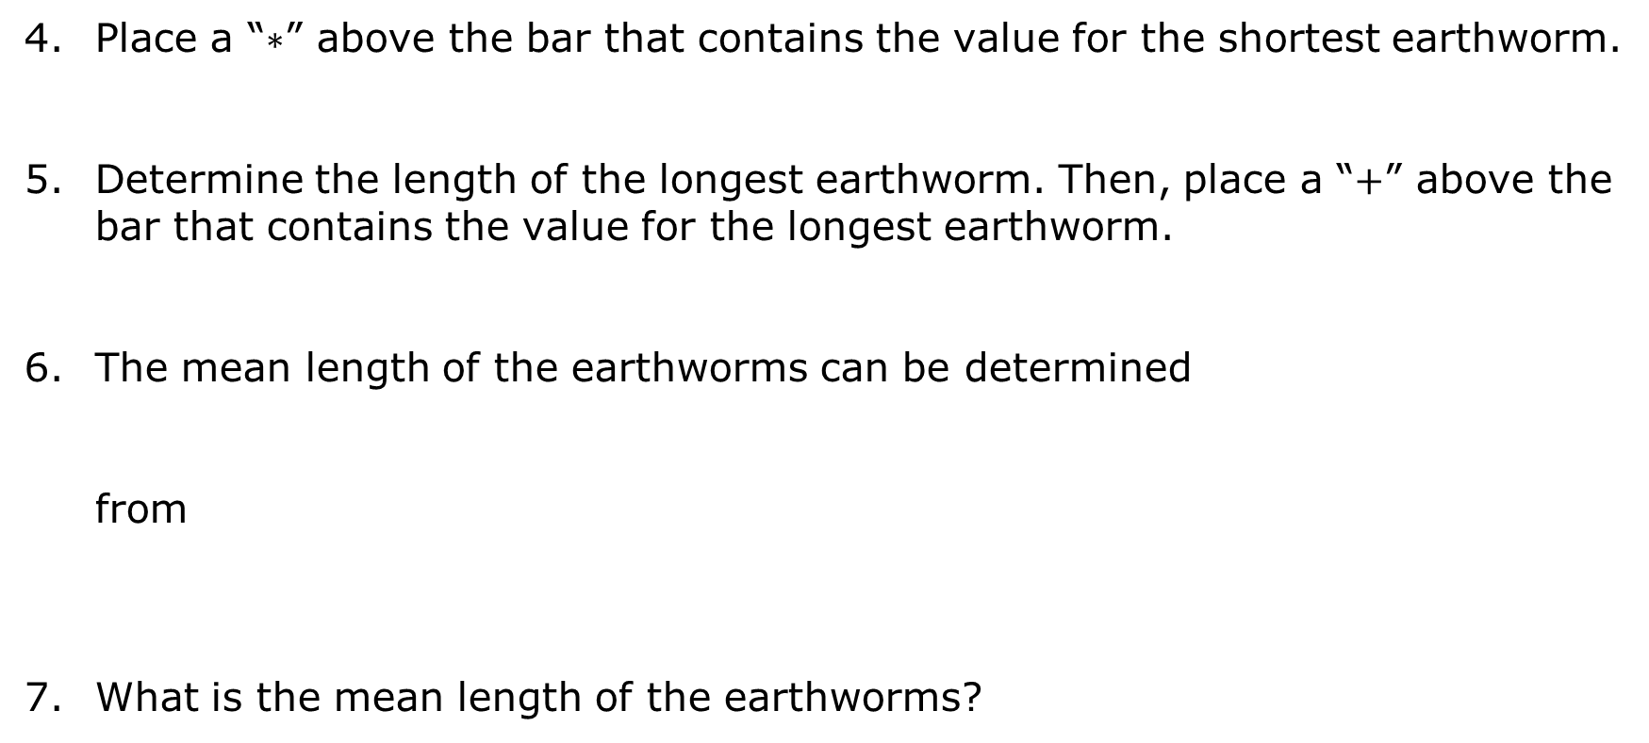
Place a “$∗$” above the bar that contains the value for the shortest earthworm.
Determine the length of the longest earthworm. Then, place a “$+$” above the bar that contains the value for the longest earthworm.
The mean length of the earthworms can be determined from
What is the mean length of the earthworms?
the data set.
the histogram.
the data set and the histogram.
volume 2, pg. 176

Slide 18
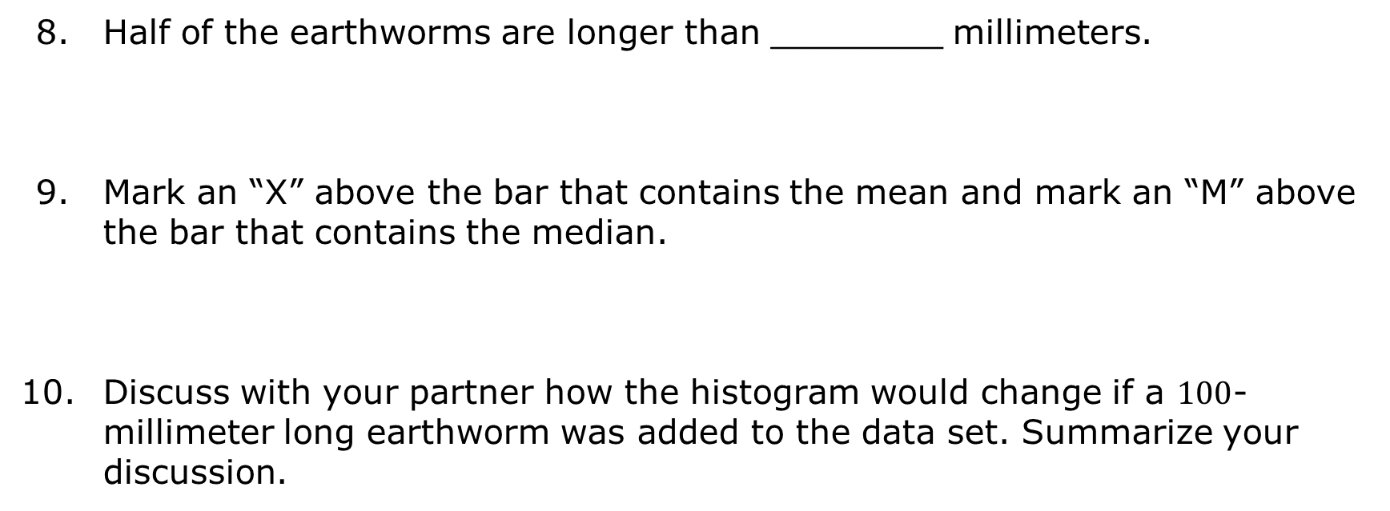
Half of the earthworms are longer than ________ millimeters.
Mark an “X” above the bar that contains the mean and mark an “M” above the bar that contains the median.
Discuss with your partner how the histogram would change if a $100$-millimeter long earthworm was added to the data set. Summarize your discussion.
volume 2, pg. 176

Slide 19

Try It
volume 2, pg. 177

Slide 20

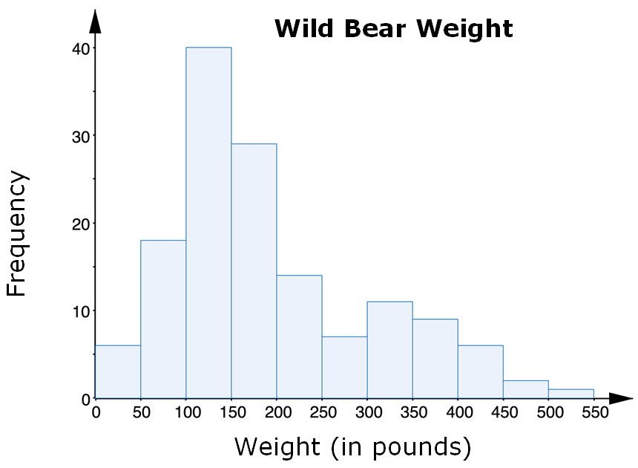
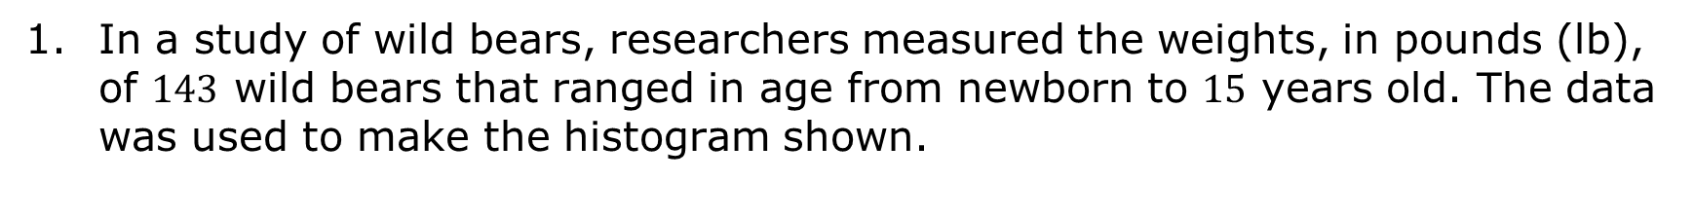
9.6.4 Try It: Analyzing Histograms
In a study of wild bears, researchers measured the weights, in pounds (lb), of $143$ wild bears that ranged in age from newborn to $15$ years old. The data was used to make the histogram shown.
volume 2, pg. 177

Slide 21
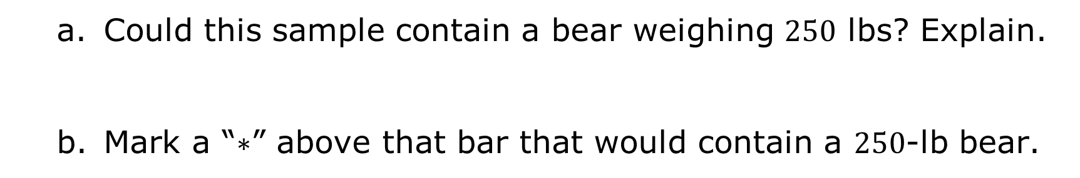
Could this sample contain a bear weighing $250$ lbs? Explain.
Mark a “$∗$” above that bar that would contain a $250$-lb bear.
volume 2, pg. 177

Slide 22
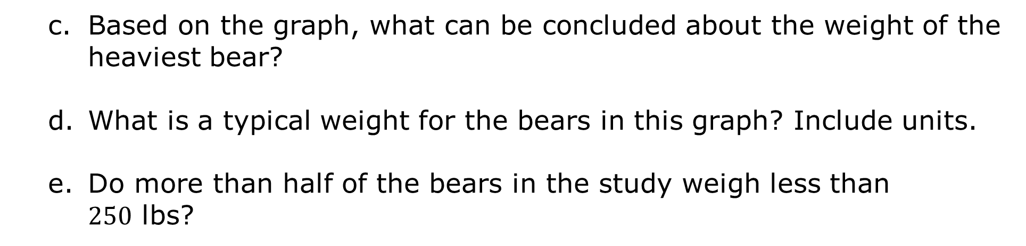
Based on the graph, what can be concluded about the weight of the heaviest bear?
What is a typical weight for the bears in this graph? Include units.
Do more than half of the bears in the study weigh less than $250$ lbs?
volume 2, pg. 177

Slide 23

Your Turn
volume 2, pg. 178

Slide 24
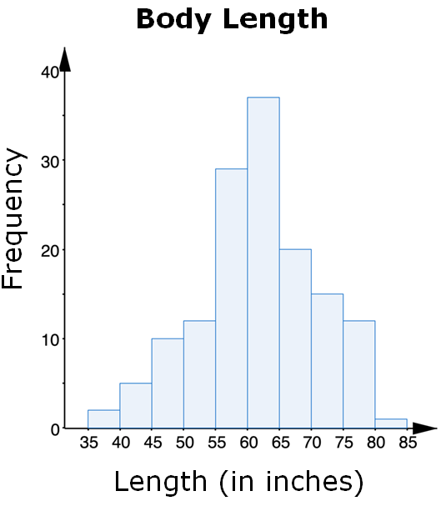
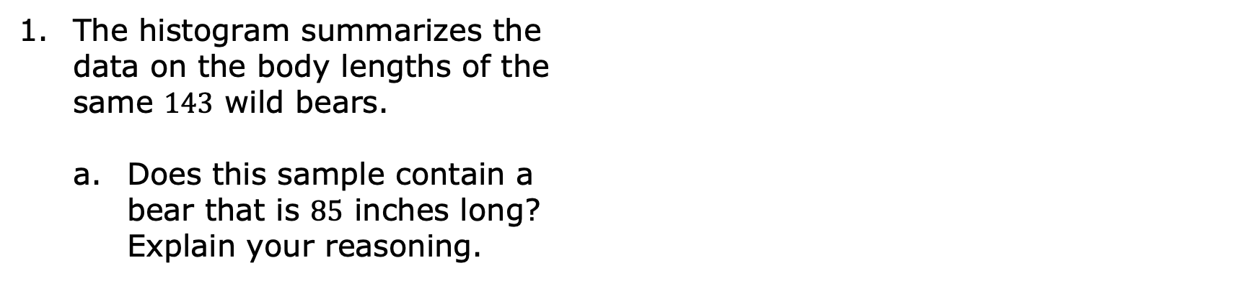
9.6.5 Your Turn!
The histogram summarizes the data on the body lengths of the same $143$ wild bears.
Does this sample contain a bear that is $85$ inches long? Explain your reasoning.
volume 2, pg. 178

Slide 25
What is a typical length for the bears in this sample? Include units.
Is the spread larger for the weight of bears or the length of bears?
volume 2, pg. 178

Slide 26

Wrap-Up
volume 2, pg. 178

Slide 27
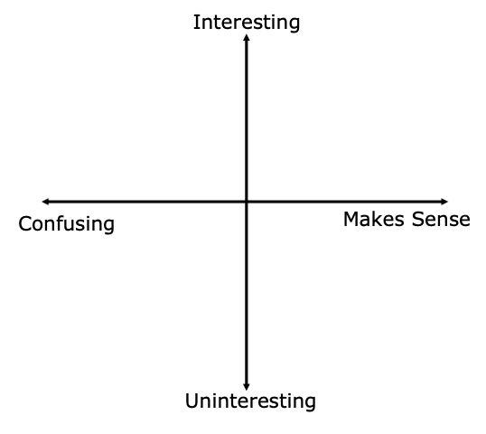
9.6.6 Wrap-Up: Reflection
Plot a point in one of the quadrants below to indicate your level of understanding of today’s learning target: “I can qualitatively describe and interpret a histogram within a real-world context.”
volume 2, pg. 178

